Slide 1


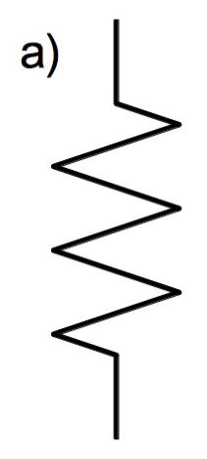
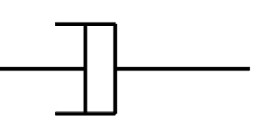



x
s(t)
$$k$$
$$υ$$
$$m$$
x
x(t)

Slide 2
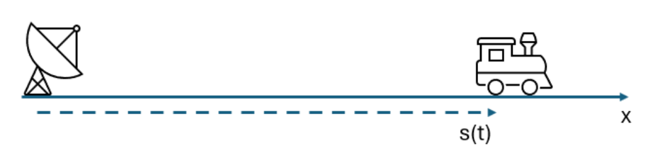






$$\dot{x}(t)$$
$$x(0)$$
$$x(t)$$
$$θ$$
$$l$$
$$m$$
x
x(t)

Slide 3
Observations
Parameters

Slide 4
















Known inputs
$$u(t)$$
Random measurement error
States at measurement time t
$$e(t)$$
$$p$$
$$x(t)$$
Measurements
$$y\left(t\right)=y_{t}\left(t\right)+e(t)$$
Parameters
Time evolution model
Measurement model
+
$$x\left(t\right)= f_{t}(p,u,q,t)$$
$$y\left(t\right)= h_{t}(x,t)$$
Random inputs
$$q(t)$$
Known inputs
$$u(t)$$
Measurements residuals
$$\tilde{y}\left(t\right)=y\left(t\right)−y_{m}(t)$$
$${\hat{p}}_{m}$$
$$y\left(t\right)$$
Parameter optimization (estimation)
Measurements
+
Time evolution model
$$\hat{x}\left(t\right)= f_{m}({\hat{p}}_{m},u,t)$$
$$y_{m}(t)$$
Model-predicted measurements
Measurement model
$$y_{m}\left(t\right)= h_{m}({\hat{x}}_{m}(t))$$
$$x_{m}(t)$$
Model-predicted states at t

Slide 5



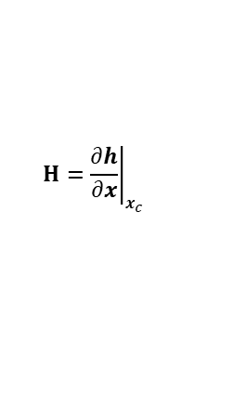








Measurement model
$$h(x)$$
$$\frac{∂h}{∂x}$$
Determine
$$x_{c}$$
Residuals
$∆y_{c}=y$- $h\left(x_{c}\right)$
Starting estimate
i = 0
$$J_{i}=\frac{1}{2m}{∆y_{c}}^{T}W{∆y}_{c}$$
$$y_{c}$$
Cost function
Measurements
$$x_{c}$$
$$W$$
$$H={\left.\frac{∂h}{∂x}\right|}_{x_{c}}$$
Weight matrix
Jacobian matrix
i = i + 1
Normal equation
No
$$∆x={\left(H^{T}WH\right)}^{−1}H^{T}W∆y$$
Yes
Stop
Max iterations?
Yes
$J<ε ?$
Stop
No
Update estimate
$x_{c}=x_{c}$+ $∆x$

Slide 6




$$y$$
$$x_{0},y_{0}$$
$$ρ(t)$$
$$x$$

Slide 7



$$x$$
$$x_{0},v_{0}$$
$$g$$

Slide 8
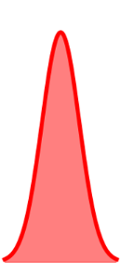
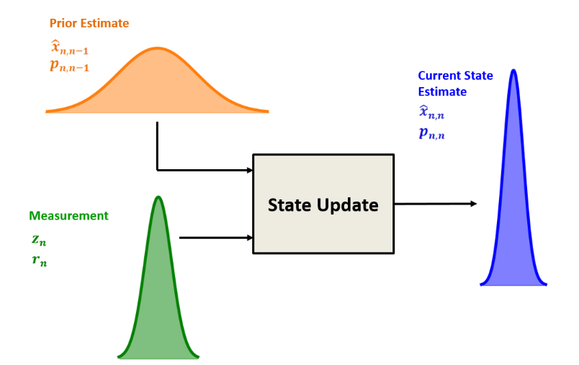
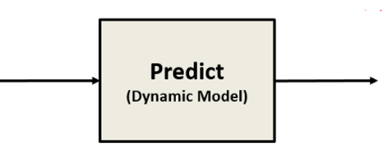








Previous state estimate
$$x_{k}$$
Predicted state estimate
$$P_{k}$$
$$x_{k+1}^{P}$$
$$P_{k+1}^{P}$$
$$x_{k+1}$$
$$P_{k+1}$$
$$y_{k+1}$$
$$R_{k+1}$$

Slide 9
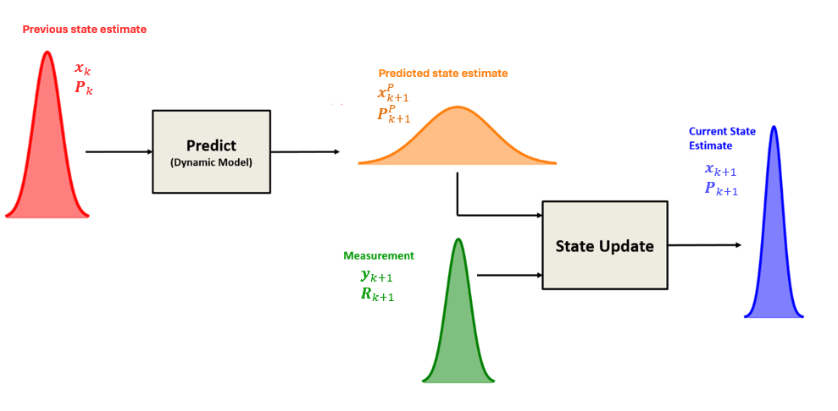

Slide 10
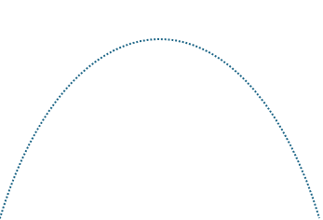









$$y$$
$$g$$
$$v_{0}$$
$$r$$
$$θ_{vel}$$
$$θ$$
$$x_{s}$$
$$x$$

Slide 11







$$Y$$
$$y$$
$$r$$
$$β$$
$$x$$
$$X$$

